Slide 1
5G Learning report
Github : https://github.com/feng-fs355/automation/tree/main/Network

Slide 2
5G NSA vs 5G SA
5G SA architecture
5G Core Network
5GC opensource 1: Magma
5GC opensource 2 : open5gs
Test Beds releated to 5G UE(UERANSIM)
Test Beds related to 5G UE (User equipment)
Test Beds related to 5G CoreNetwork (CD-Router)
5G testing reference from AWS
Layer 2 Qos 802.1p (DSCP) test reference
Layer 3 Qos (PHB)

Slide 3
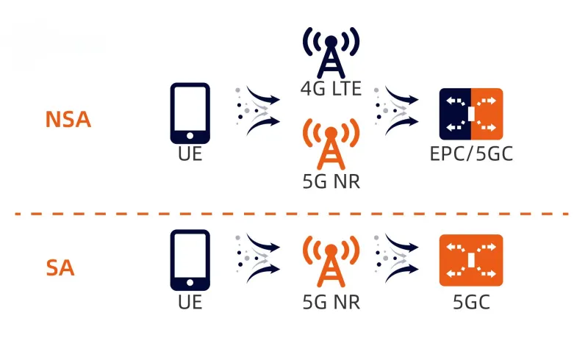
5G NSA vs 5G SA
NSA = Non-Standalone
-> 4G + 5G
SA = Standalone
-> 5G New Radio access only

Slide 4
5G NSA
https://source.android.com/docs/core/connect/5g-nsa?hl=zh-tw
Devices running Android 10 or higher can support 5G non-standalone (NSA). 5G NSA is a solution for 5G networks where the network is supported by the existing 4G infrastructure. On Android 10, devices can display a 5G icon on the status bar when a device connects to a 5G network.

Slide 5
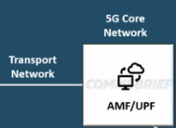
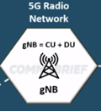

2. 5G SA architecture
5GC
RAN
gNB
DU : Provide Radio network access CU : Provide Network Protocol stack
Internet
5G CPE

Slide 6
5G Core Network function
1.User Access and Authentication(authentication ): Relate to the UE connect to the 5G access network
2.Session Management(Voice,Data,other communication service):
Related to UE connection has been created,establishing, maintaining, and releasing communication sessions. This includes voice calls, data transfers, and other communication services.
3.Mobility Management(roaming): The core network handles the switching and roaming of UE as they move.
4.Network Slicing Support(SDN, NFV):
The 5G core network supports network slicing technology, allowing network resources to be dynamically allocated to meet the specific requirements of different services and applications.
5.Edge Computing and Low Latency (Low latency , IoT): Keyword: reducing latency , especially for applications requiring low latency, such as the Internet of Things (IoT) and augmented reality.
6.Security and Privacy(Security):
The core network is responsible for managing the security and privacy of communications. It employs encryption and authentication technologies to protect data transmission and ensures the appropriate safeguarding of user information.
Reference: https://ws-proj.moe.edu.tw/Download.ashx?u=LzAwMS9VcGxvYWQvNTc2L3JlbGZpbGUvMTMwOTcvMzk4L2VkOTMzNGY4LTJmOTYtNDc2My05M2NiLTM0Nzg3NGQ2MmVmMC5wZGY%3D&n=MDEuIOWKiei7kuS9kSAtLSA1R%2BiIh%2Be2sui3r%2BWIh%2BeJh%2BWwjuirli5wZGY%3D

Slide 7
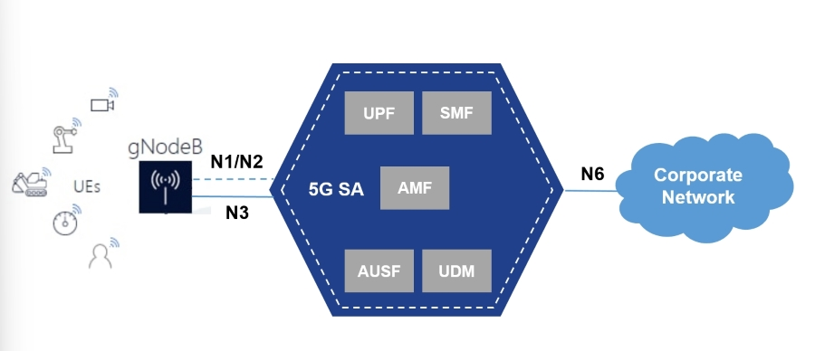
3. 5G Core Network
N1 Interface is based on 3GPP TS 38.413 version 16.2.0 Release 16
N2 Interface is based on 3GPP TS 24.501 version 15.3.0 Release 15
N3 Interface is based on 3GPP TS 29.281 version 15.7.0 Release 15
(1)N1 interface is between the UE and the AMF (Accessibility & Mobility Management Function). The N1 interface is used by the UE for non-radio signaling mainly NAS(Non access stratum) layer signaling. N1 N2 acts as the interface between gNodeB and AMF. (2)N2 Interface (AN(access stratum) <-> AMF) : Paging ,Handover,UE mobility,related to PDU Session resource setup
(3)N3 interface: Interface between the RAN (gNB) and the (initial) UPF.(User Plane Function (UPF))

Slide 8
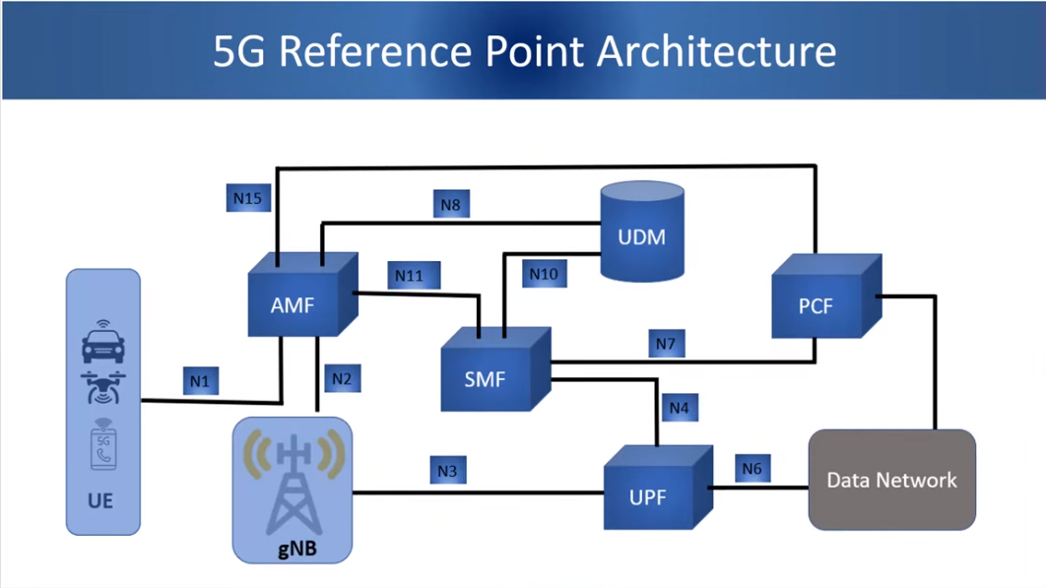
(1)N1 interface is between the UE and the AMF (Accessibility & Mobility Management Function).
(2)N2 Interface (AN(access stratum) <-> AMF) : Paging ,Handover,UE mobility,related to PDU Session resource setup
(3)N3 interface: Interface between the RAN (gNB) and the (initial) UPF.
N1 , N2 , N3
User Plane Function (UPF) https://techcommunity.microsoft.com/t5/azure-for-operators-blog/what-is-the-5g-user-plane-function-upf/ba-p/3690887 https://www.youtube.com/watch?v=Wj9tw0TGzls

Slide 9
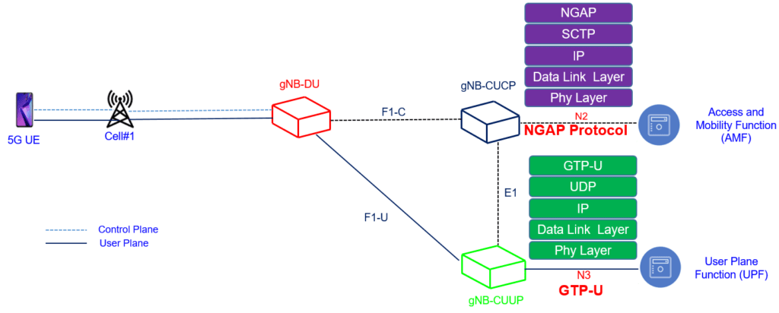
Reference: (1) https://ithelp.ithome.com.tw/articles/10295681 (2) https://www.youtube.com/watch?v=dp_tHjYcmJY
(3) https://ithelp.ithome.com.tw/articles/10294923
N1
N3
N3

Slide 10
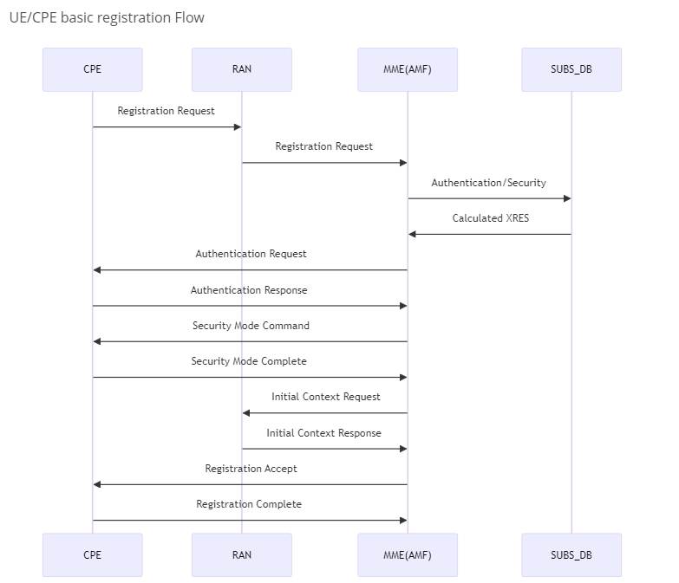
4. 5GC opensource 1 : Integrated 5G SA FWA
https://magma.github.io/magma/docs/next/lte/integrated_5g_sa
Prerequisites
Before starting to configure 5G SA setup, first you need to bring up a setup to handle your own/local subscribers. So before configuring Inbound Roaming you need:
Install Or8cr,
Install Federatetion Gateway and,
Install Access Gateway.
Make sure your setup is able to serve calls with your local subscribers

Slide 11
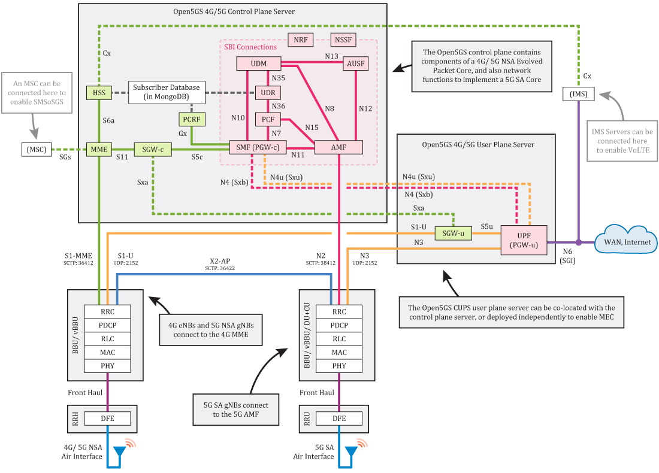
5. 5GC opensource 2 : open5gs and ueransim
https://nickvsnetworking.com/my-first-5g-core-open5gs-and-ueransim/
https://open5gs.org/open5gs/docs/guide/01-quickstart/

Slide 12
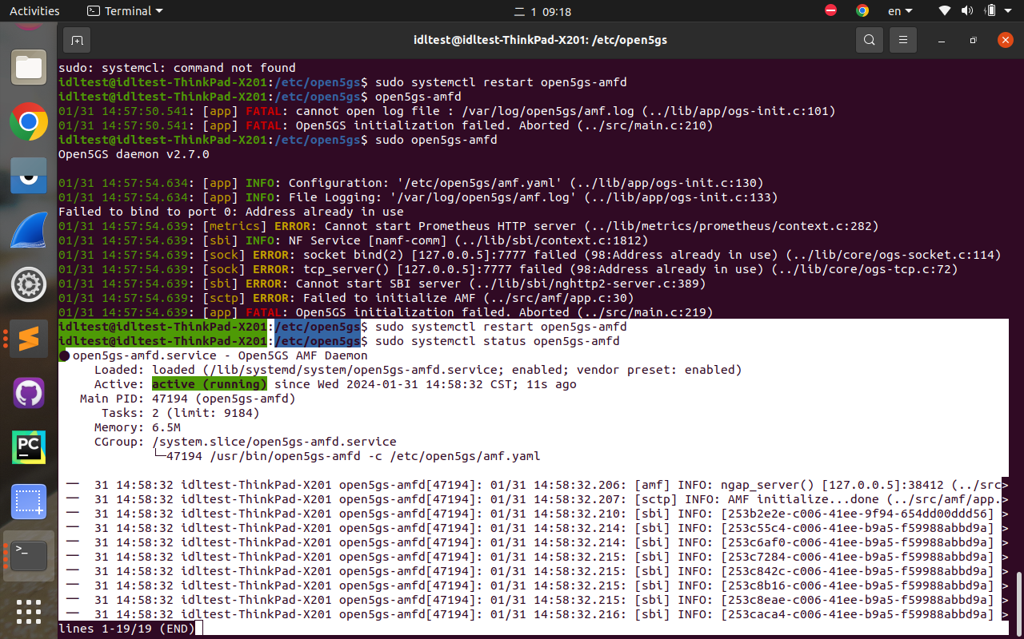

Slide 13

.Test Beds related to 5G UE (User equipment)
Test SIM - PySIM
pySim is a small command-line tool to program(write to) a variety of programmable sim cards.
https://downloads.osmocom.org/docs/pysim/master/html/
https://www.youtube.com/watch?v=xvdLCqSDAMY

Slide 14
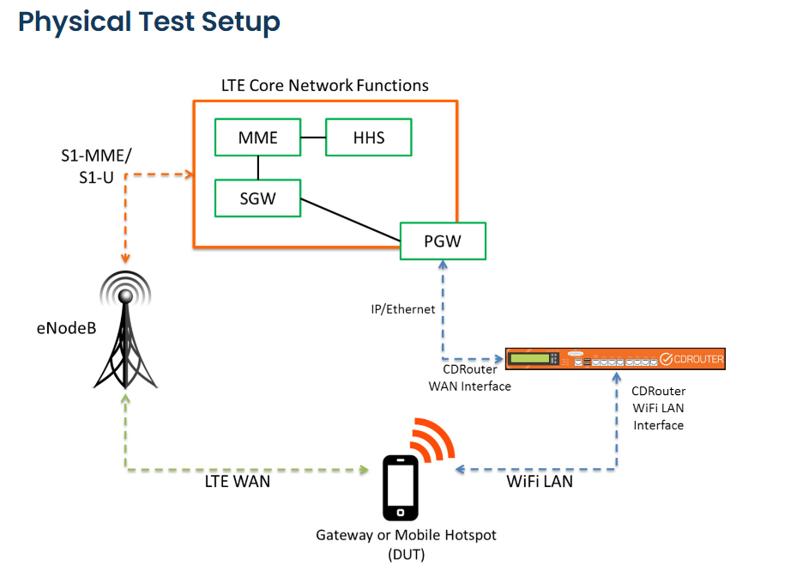
. Test Beds related to 5G CoreNetwork (CD-Router)
Potential 5G test setup refer from 4G Test suites
https://www.qacafe.com/resources/2017-04-06-test-setup-lte-gateway-mobile-hotspot/

Slide 15
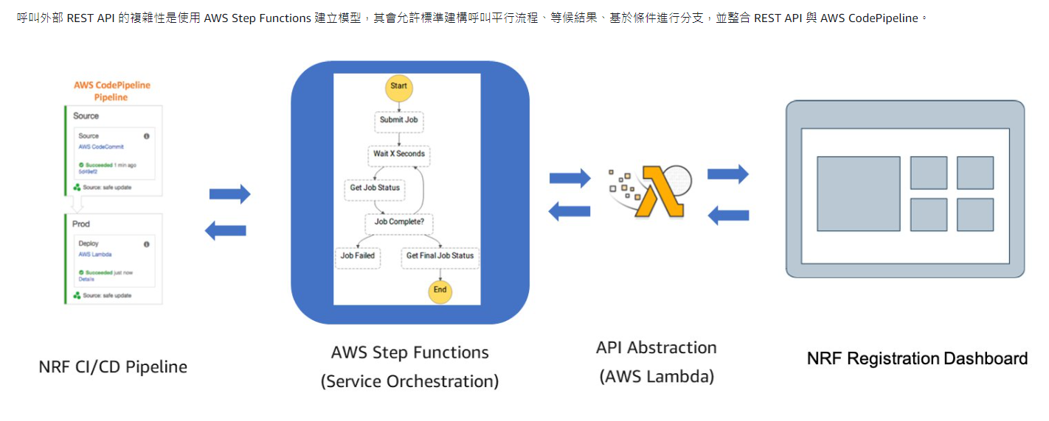
8. 5G testing reference from AWS
https://docs.aws.amazon.com/zh_tw/whitepapers/latest/cicd_for_5g_networks_on_aws/testing.html

Slide 16
10. Layer 2 Qos 802.1p (DSCP) test reference
Keyword : Vlan user priority Purpose: The QoS VLAN Priority lets you assign a priority to outbound packets containing the specified VLAN-ID (VID).
How to Test ? example: IXIA
https://www.youtube.com/watch?v=ogqUlxsafUA
https://techlibrary.hpe.com/device_help/ProCurveJ9562A/conf/qualityofservice/qosdiffserve.htm

Slide 17
TOS Value | VLAN Priority | Device Priority
111000 - Network_Control | 7 | 1
110000 - Internetwork_Control | 6 | 1
101000 - Critical_/_Realtime | 5 | 2
100000 - Interactive_1 | 4 | 2
011000 - Interactive_2 | 3 | 3
010000 - Batch_1 | 2 | 3
001000 - Batch_2 | 1 | 4
000000 - Best_Effort | 0 | 4
Any DSCP value | 0 | 4
https://www.ibm.com/docs/en/zos/2.3.0?topic=tagging-specific-interface

Slide 18
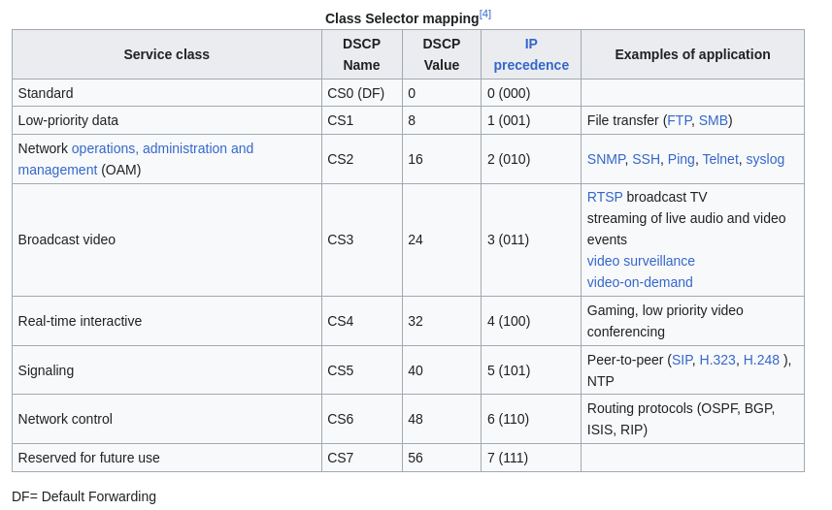
11. Layer 3 Qos
DiffServ is a coarse-grained, class-based mechanism for traffic management. In contrast, IntServ is a fine-grained, flow-based mechanism. DiffServ relies on a mechanism to classify and mark packets as belonging to a specific class. DiffServ-aware routers implement per-hop behaviors (PHBs), which define the packet-forwarding properties associated with a class of traffic. Different PHBs may be defined to offer, for example, low-loss or low-latency service.

